Slide 1
System Engineering

Slide 2
In software engineering, a system/system environment refers to a set of interconnected components that work together to accomplish a specific function or set of functions. These components can include:
Software (programs, modules, services)
Hardware (servers, devices, infrastructure)
Users (people who interact with the software)
Data (input, output, and stored information)

Slide 3
Key Characteristics of a System:
Purposeful: Designed to achieve specific goals (e.g., banking system, ticket booking system).
Structured: Has a defined architecture and flow.
Interconnected: All parts depend on each other to work correctly.
Boundary-defined: Has clear inputs and outputs.
Operates in an environment: Interacts with external entities (e.g., users, other systems).

Slide 4
Here are the stages of the System Development Life Cycle (SDLC):
Planning
System Analysis
System Design
Development (Implementation)
Testing
Deployment
Maintenance

Slide 5
Feature | Software Development Life Cycle | System Development Life Cycle
🔍 Focus | Only on software components | Focus on entire system – software, hardware, people, etc.
🎯 Goal | To build and maintain software applications | To develop a complete system that may include software, hardware, policies, and people
👥 Who uses it | Software engineers, developers, testers | System analysts, IT managers, architects
⚙️ Scope | Limited to coding, testing, deployment, and maintenance | Broader: includes infrastructure, security, networking, workflows
🧪 Testing Involves | Functional, integration, system testing for software | Includes hardware/software integration testing, network testing
🛠️ Example | Developing a mobile banking app | Building a complete banking system with ATMs, databases, servers, and software
🧱 Includes | Planning, requirements, design, coding, testing, deployment | All software SDLC phases plus hardware setup, user roles, workflows, compliance
🔁 End Product | A software product (e.g., website, app) | A complete IT system ready to be used in the real world

Slide 6
👨‍Role of a System Analyst
A System Analyst acts as a bridge between business needs and technical solutions.
🔑 Key Responsibilities:
Requirement Gathering – Understand what users and businesses need.
Feasibility Study – Check if the system is technically, financially, and legally possible.
System Design – Help design the structure and flow of the system.
Communication – Liaise between clients, developers, and stakeholders.
Problem Solving – Analyze current systems and suggest improvements.
Documentation – Create clear system requirements and process documents.
Testing & Evaluation – Ensure the system meets user expectations.

Slide 7
Concept of MIS (Management Information System)
MIS stands for Management Information System — it's a system that provides managers with data-driven insights to make better decisions.
Purpose of MIS:
Collect, process, store, and distribute relevant information.
Help in planning, controlling, and decision-making at all management levels.

Slide 8
🔧 Components of MIS:
Hardware – Computers, networks.
Software – Applications used for processing data.
Database – Stores organizational data.
People – Users like managers, analysts.
Procedures – Rules and policies for data handling.
🏢 Example:
A retail company’s MIS might track sales, inventory, and customer data to help management plan future marketing or restocking.

Slide 9
Tools of Structured Analysis (in System Engineering):
Structured analysis is a method used to understand and model a system clearly before building it. It uses visual tools to break down complex systems into smaller, manageable parts.
🔧 Common Tools:
Data Flow Diagram (DFD) – Shows how data moves through the system.
Entity-Relationship Diagram (ERD) – Shows data entities and relationships (used for databases).
Data Dictionary – Defines data elements and their meanings.
Process Specification (P-Specs) – Describes in writing after a DFD what each process does in detail.
Decision Trees / Tables – Represent logical conditions and actions.
✅ These tools help in analyzing system requirements clearly before design and development.

Slide 10
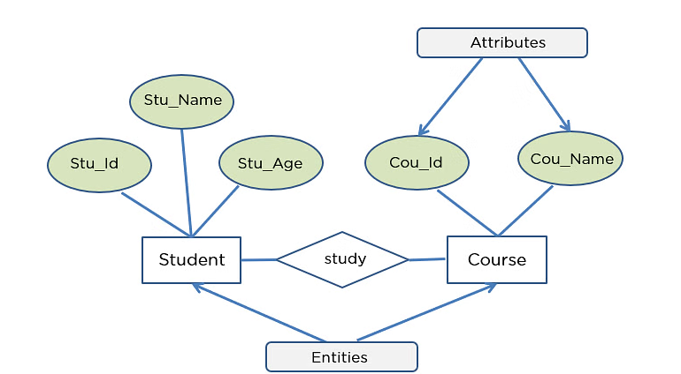
ER Diagram for Database Design

Slide 11
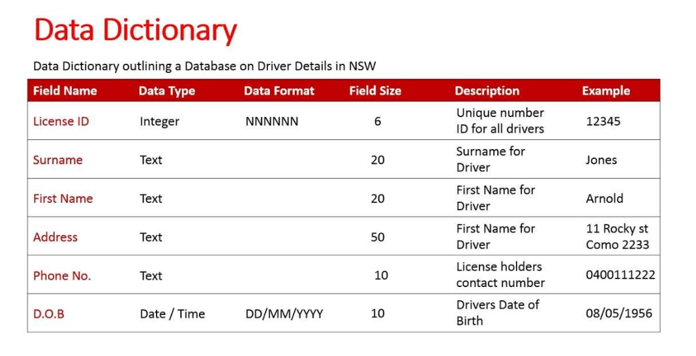

Slide 12
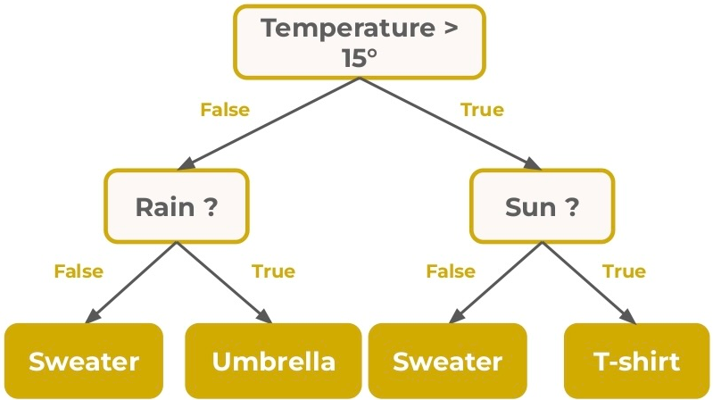
Decision Tree

Slide 13
💰 Cost/Benefit Analysis (CBA) in System Engineering:
Cost/Benefit Analysis is the process of comparing the expected costs of a system against the expected benefits to see if the project is worth doing.
📈 It Includes:
Costs:
Hardware, software, labor, training, maintenance.
Benefits:
Time savings, increased efficiency, better decision-making, cost reduction.
🔍 Purpose:
To decide whether the system is financially and practically feasible. If benefits > costs, the project is usually approved.

Slide 14
System Design stages:
Preliminary Design – Plan overall system structure and main modules.
Detailed Design – Design each module’s functions and data.
Interface Design – Plan how users and systems interact.
Database Design – Define database structure.
System Architecture – Decide hardware, network, and security.
Review – Check design against requirements.

